Slide 1
SWDVC301:VERSION CONTROL

Slide 2
Steps to perform git configuration:
The steps to perform Git configuration:
1. Verify that Git is installed
After the installation is complete, Sarah opens a new terminal or command prompt to verify that Git is installed. She runs the following command:

Slide 3
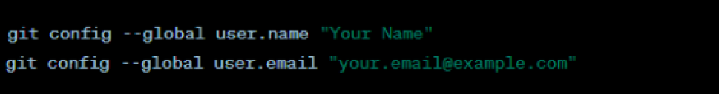
2. Set Your Name and Email:
Use the git config command to set your name and email. This information will be associated with your commits.
Replace "Your Name" with your actual name and "your.email@example.com" with your actual email address.

Slide 4
3. Configure Your Preferred Text Editor:
Set your preferred text editor for Git commit messages. This is the editor that will open when you make a commit.
For example, if you want to use Visual Studio Code:
Replace "code" with the command for your preferred text editor.

Slide 5
4. Check Your Configuration:
To view your Git configuration, use the following command:
5. Configure Default Branch Name (Optional):
If you want to use a branch name other than "master" or "main" as the default branch name for new repositories, you can configure it:
Replace "main" with your preferred default branch name.

Slide 6
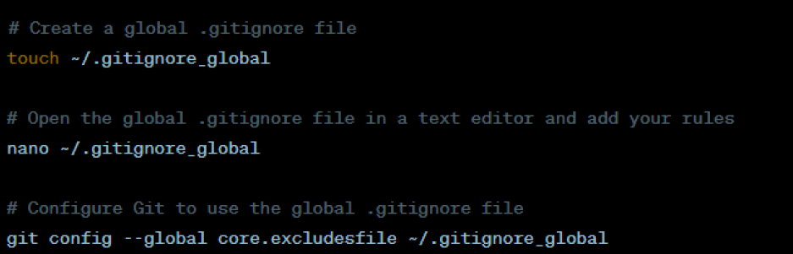
6. Set Up a Global .gitignore (Optional):
If you want to use a global .gitignore file across multiple repositories, you can create a global .gitignore file and tell Git to use it:

Slide 7
7. Verify the installation:
Check Which Version of Git You’re Using
The command to check which version of Git you’re using is the same on both Windows and Mac. To check your Git version, open Command Prompt (Windows), Terminal (Mac), or the Linux terminal. Once open, run this command:

Slide 8
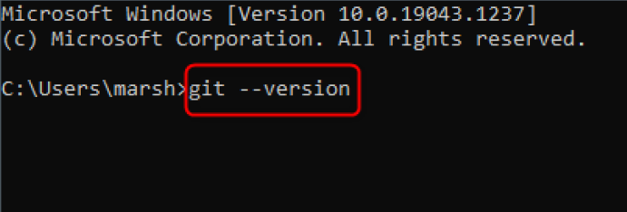
git --version
The Git version you’re currently using will be returned.

Slide 9
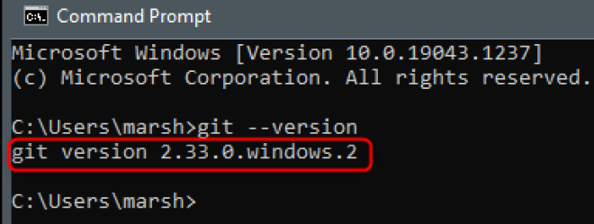
Now that you know which version of Git you’re using, you can decide if you want to update it or not.

Slide 10
How to Update Git on Windows
The command you use to update Git on Windows depends on which version of Git you’re currently using. If you’re using any version from 2.14.2 to 2.16.1, then run this command in Command Prompt:
git update
If you’re using any version after 2.16.1, then you’ll need to run this command instead:

Slide 11
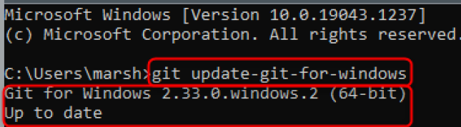
git update-git-for-windows
Regardless of which command you need to use, your Git version will update or you’ll get a message saying you’re up to date if you’re already using the latest version.

Slide 12
Apply Git configuration
The git config command is used to set or get configuration variables in Git. These variables can control various aspects of Git's behavior, such as user information, default behavior, and repository settings.
Some practical Git configurations with examples:

Slide 13
1. Set your name and email:
git config --global user. name "Your Name."
git config --global user.email "your@email.com"
This configuration sets your name and email globally, which will be used for all your Git commits.
2. Configure your preferred text editor:
git config --global core.editor "vim"
This configuration sets Vim as the default text editor for Git. You can replace "vim" with the name of your preferred editor.

Slide 14
3. Set default branch name:
git config --global init.defaultBranch "main"
This configuration sets the default branch name to "main" when creating a new repository.
4. Enable colored output:
git config --global color.ui true
This configuration enables colored output in Git's command-line interface, making it easier to read and interpret.

Slide 15
Syntax to create a git repo using the git init command:
git init
This command will initialize a new Git repository in the current working directory. So, before you run the command, make sure you are in the directory in which you want to initialize a repository.
Alternatively, you can specify the directory in which the new repository should be initialized. The syntax for doing so is as follows:

Slide 16
git init <folder>
Suppose we wanted to initialize a repository in a folder called demo-project. We could do so using this code:
git init demo-project
When we run this command, a .git folder is created within our demo-project folder, instead of in our current working directory.

Slide 17
1.3.1: Description of GitHub
1. Definition of GitHub
GitHub is a large platform for code hosting. It supports version control and collaboration, allowing developers to work together on projects. It offers both distributed version control and source code management (SCM) functionality of Git. It also facilitates collaboration features such as bug tracking, feature requests, and task management for every project.

Slide 18
Essential components of GitHub are:
Repositories
Branches
Commits
Pull Requests
Git (the version control tool GitHub is built on)

Slide 19
2. Benefits of GitHub
The key benefits of GitHub are as follows.
It is easy to contribute to open-source projects via GitHub.
It helps to create an excellent document.
You can attract the recruiter by showing off your work. If you have a profile on GitHub, you will have a higher chance of being recruited.
It allows your work to get out there in front of the public.
You can track changes in your code across versions.

Slide 20
3. Features of GitHub
Some of its key features:
Collaboration
Bug tracking
Branches
Git repositories
Project management
Team management
Code hosting
Track and assign tasks

Slide 21
4. GitHub vs. Git
Git is an open-source distributed version control system that is available for everyone at zero cost.
It is designed to handle minor to major projects with speed and efficiency.
It is developed to coordinate the work among programmers. While
GitHub is an immense platform for code hosting. it supports version control and collaboration.

Slide 22
It offers both distributed version control and source code management (SCM) functionality of Git.
It also facilitates collaboration features such as bug tracking, feature requests, and task management for every project.
5. Git commands related to the repository
There are several Git commands related to managing and working with repositories. Here are some common examples of these commands:

Slide 23
1. `Git init`: Initializes a new Git repository in the current directory, creating a new `.git` folder to store version control information.
2. `Git clone <repository-url>`: Creates a local copy of a remote repository. The repository URL can be obtained from the hosting platform (e.g., GitHub, GitLab).
3. `Git remote add <name> <repository-url>`: Adds a remote repository to your local repository. The `<name>` is an alias for the remote repository, and the `<repository-url>` is the URL of the remote repository.

Slide 24
4. `Git remote -v`: Lists the remote repositories associated with your local repository, along with their URLs.
5. `Git pull <remote> <branch>`: Fetches changes from a remote repository and merges them into the current branch in your local repository.
6. `Git push <remote> <branch>`: Pushes your local commits to a remote repository. The `<remote>` is the remote repository alias, and the `<branch>` is the branch name.

Slide 25
7. `Git branch`: Lists all the branches in your local repository. The current branch is indicated with an asterisk.
8. `Git branch <branch-name>`: Creates a new branch with the specified name.
9. `Git checkout <branch-name>`: Switches to the specified branch.
10. `Git checkout -b <branch-name>`: Creates a new branch with the specified name and switches to it.
11. `Git merge <branch-name>`: Merges changes from the specified branch into the current branch.

Slide 26
12. `Git status`: Shows the current status of your local repository, including modified files, new files, and branch information.
13. `Git log`: Displays a log of commits in reverse chronological order, showing commit hashes, authors, dates, and commit messages.
14. `Git add <file>`: Adds a file to the staging area, preparing it for committing.
15. `Git commit -m "<commit-message>"`: Commits the changes in the staging area with a descriptive commit message.
16. `Git push --tags`: Pushes any tags that have been created to the remote repository.

Slide 27
1.3.2: Creating an account and a repository on GitHub
1. Create a GitHub Account
After installing Git on your machine, the next step is to create a free GitHub account by following these steps:
1. Visit the official account creation page by joining GitHub
2. Pick a username, enter your email address, and choose a password.
3. Opt for or opt out of receiving updates and announcements by checking/unchecking the Email preferences checkbox.

Slide 28
4. Verify you're not a robot by solving the Captcha puzzle.
5. Click Create account.
6. GitHub sends a launch code to the specified email address. Copy-paste the code in the designated field.
7. Optionally, enter account personalization details when asked or Skip, and click Continue.
You have now successfully created a GitHub account.

Slide 29
2. Create a Local Git Repository
After installing or updating Git, the next step is to create a local Git repository.
To create a Git repository, follow the steps below:
Open a Git Bash terminal and move to the directory where you want to keep the project on your local machine. For example:

Slide 30
cd ~/Desktop
mkdir myproject
cd myproject/
In this example, we changed the directory to Desktop and created a subdirectory called myproject.
2. Create a Git repository in the selected folder by running the git init command. The syntax is:

Slide 31
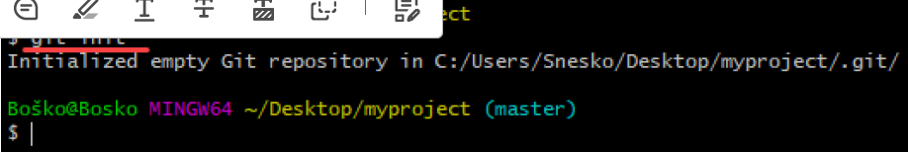
git init [repository-name]
Now you have successfully created a local Git repository.

Slide 32
3. Create New Repository on GitHub
GitHub allows you to keep track of your code when you're working with a team and need to modify the project's code collaboratively.
Follow these steps to create a new repository on GitHub:
1. Log in and browse to the GitHub home page.
2. Find the New repository option under the + sign next to your profile picture, in the top right corner.

Slide 33
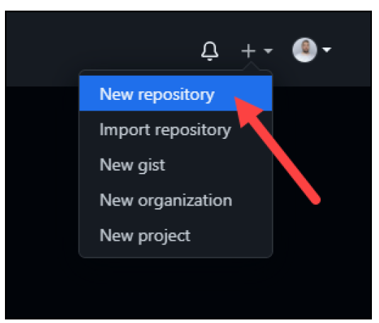
3. Enter a name for your repository, provide a brief description, and choose a privacy setting.

Slide 34
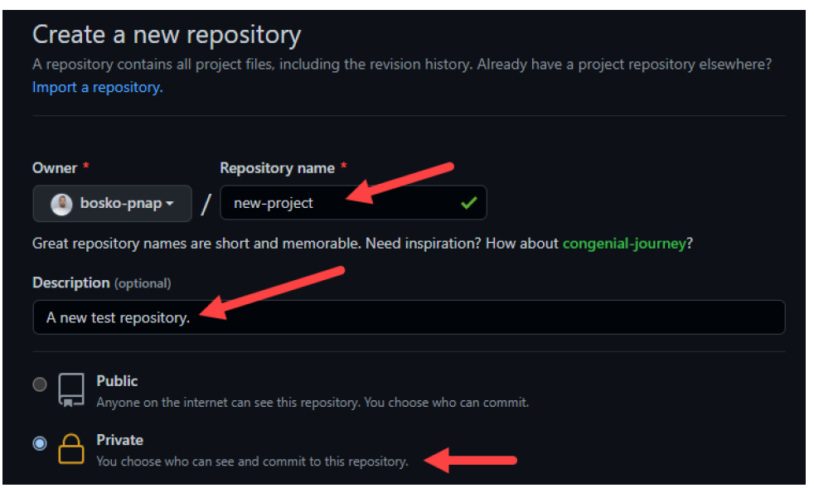
4. Click the Create repository button.
GitHub allows you to add an existing repo you have created locally.

Slide 35
4.Git commands related to repository
1. git init: Initializes a new Git repository in the current directory.
Example:
$ git init
2. git clone <repository>: Creates a copy of a remote repository on your local machine.
Example:
$ git clone https://github.com/user/repository.git

Slide 36
3. git remote add <name> <url>: Adds a remote repository to your local repository.
Example:
$ git remote add origin https://github.com/user/repository.git
git remote remove <name>: Removes a remote repository from your local repository.
Example:
$ git remote remove origin

Slide 37
5. git remote -v: Lists the remote repositories associated with your local repository.
Example:
$ git remote -v
6. git fetch <remote>: Fetches the latest changes from a remote repository without merging them.
Example:
$ git fetch origin

Slide 38
7. git pull <remote> <branch>: Fetches the latest changes from a remote repository and merges them into the current branch.
Example:
$ git pull origin main
8. git push <remote> <branch>: Pushes your local changes to a remote repository.
Example:
$ git push origin main

Slide 39
9. git branch: Lists all the branches in your repository.
Example:
$ git branch
10. git branch <branch_name>: Creates a new branch in your repository.
Example:
$ git branch new-feature
11. git checkout <branch>: Switches to an existing branch in your repository.
Example:
$ git checkout main

Slide 40
12. git checkout -b <branch_name>: Creates and switches to a new branch in your repository.
Example:
$ git checkout -b new-feature
13. git merge <branch>: Merges a branch into the current branch.
Example:
$ git merge feature-branch

Slide 41
14. git add <file>: Adds a file to the staging area to be included in the next commit.
Example:
$ git add myfile.txt
15. git commit -m "<message>": Commits the changes in the staging area with a descriptive message.
Example:
$ git commit -m "Fix bug #123"

Slide 42
16. git log: Displays a log of commits in reverse chronological order.
Example:
$ git log
17. git status: Shows the current state of your repository, including any untracked, modified, or staged files.
Example:
$ git status
18. git diff: Shows the differences between the working directory and the staging area.
Example:
$ git diff

Slide 43
Steps to follow when performing the git-config command
1. Open a terminal or command prompt
2. Check existing configurations (optional)
3. Set global or local configurations
4. Modify existing configurations
5. Remove configurations
6. Confirm configurations

Slide 44
Learning Outcome 2: Manipulate Files
Indicative content 2.1: Add file change to Git staging area
2.1.1: Description of staging area
1. The staging area
In Git, the staging area, also known as the index, is a crucial intermediate step in the Git workflow that allows users to prepare and organize changes before committing them to the repository.

Slide 45
By using the `git add` command, users can move specific changes from the working directory to the staging area, effectively staging them for the next commit.
2. Git status command
2.1 Definition of the git status command
The "git status" command is a command used in the Git version control system to display information about the current state of the repository, such as the status of tracked and untracked files, the branch being worked on, and any changes that have been made.

Slide 46
2.2 Operations on the git status command
1. View new untracked files:
When you run `git status`, it will display a section titled "Untracked files" that lists any new files in your working directory that Git is not currently tracking. These files have not been staged or included in any previous commits. It provides you with a list of files that you may want to consider adding to your repository.

Slide 47
2. View modified files:
In the "Changes not staged for commit" section of the `git status` output, you will see a list of modified files in your working directory that have not been staged. These files have changes compared to the last commit. Git will show you the names of the modified files so that you can review the changes made to them.

Slide 48
3. View deleted files:
Similarly, in the "Changes not staged for commit" section, `git status` will also display any deleted files that have not been staged. These are files that were present in the last commit but have been deleted in your working directory since then. Git will show you the names of the deleted files, allowing you to review the deletions.

Slide 49
The git add command is used to add changes or new files to the staging area in Git. It prepares the changes or files to be included in the next commit.
3. Git add command
3.1 Definition of the git add command
The "git add" command is used in Git to add changes or new files to the staging area. The staging area is a temporary storage space where you can gather and prepare changes before committing them to the Git repository.

Slide 50
After using the "git add" command, the changes or files you specified will be moved to the staging area. You can then review the changes using "git status" and proceed with committing them using the "git commit" command.
The git add command is used to add file contents to the Index (Staging Area).

Slide 51
3.2 Operations on git add command
1. Stage all files:
When you use the `git add .` command, Git scans the current directory and its subdirectories, identifying any modified and new files. It adds these files to the staging area, which is a space where you can prepare your changes for the next commit.

Slide 52
2. Stage a file:
When you use the `git add <file>` command, Git adds the specified file to the staging area. This means that Git records the current state of the file, including any modifications you made to it since the last commit.
3. Stage a folder:
Git does not have a direct command to stage a folder. However, when you use the `git add <folder>` command, Git scans the specified folder and its subdirectories. It identifies any modified and new files within the folder and adds them to the staging area.

Slide 53
4. Git reset command
4.1 Definition of git reset command
The "git reset" command is used in Git to move the HEAD and branch pointer to a specific commit or to unstage changes. It allows you to manipulate the commit history and the staging area. The behavior of "git reset" varies depending on the options and arguments used.

Slide 54
4.2 Operations on git reset command
1. Unstage a file:
When you want to remove a file from the staging area without discarding the changes made to that file, you can use the `git reset` command. Specifically, the `git reset <file>` command allows you to unstage a specific file.
By running `git reset <file>`, Git moves the specified file from the staging area back to the working directory.

Slide 55
Unstaging a file with `git reset` provides flexibility in managing your staged changes, allowing you to selectively remove files from the staging area while retaining the modifications made to them.
2. Deleting and staging a folder:
Git does not have a direct command to delete or stage a folder. However, you can achieve the desired effect by combining different Git commands, including `git reset`.

Slide 56
To delete a folder and stage the deletion, you can follow these steps:
1. Use the `git rm -r <folder>` command to recursively remove the folder and its contents from both the working directory and the Git repository. This permanently deletes the folder and its files.
2. Run `git reset` to unstage the deletion. For example, `git reset <folder>` or `git reset .` (to unstage all changes).

Slide 57
5. Rm command
5.1 Definition of rm command
The "git rm" command is used in Git to remove files from the Git repository. It is primarily used to delete files that are tracked by Git and stage the deletion for the next commit.
1. Removing a file from the repository: You can use the following command to remove a file from the Git repository and stage the deletion: git rm <file>

Slide 58
2. Removing a file from the repository without deleting it locally: If you want to remove a file from the Git repository but keep it in your local working directory, you can use the "--cached" option with "git rm". For example: git rm --cached <file>
Removing multiple files or using shell patterns: You can use shell patterns or specify multiple files to remove multiple files at once. For example:
git rm *.txt

Slide 59
5.2 Operations on rm command
1. Remove and stage a file:
The `git rm` command allows you to remove a file from both your working directory and the Git repository, while also staging the removal. When you run the following command: git rm <file>
2. Remove and stage a folder:
Git does not have a direct command to remove and stage a folder. However, you can achieve the desired effect by combining different Git commands, including the `git rm` command.

Slide 60
Run `git rm -r --cached <folder>` to stage the removal of the folder:
git rm -r --cached <folder>
2.1.2: Applying Git commands to change files
1. Adding file change to staging area.
To add file changes to the Git staging area, follow these steps:
1. Check the Status:
Before adding file changes, check the status of your repository using `git status` to see which files have been modified.

Slide 61
2. Add Changes:
Use the `git add` command followed by the filename to stage specific changes. For example, to stage a single file, use `git add <filename>`.
3. Stage All Changes:
To stage all changes in the working directory, you can use `git add ` to add all modified files or `git add --all` to include all changes, including deleted files.

Slide 62
4. Review Staged Changes:
Verify the changes staged for commit by running `git status` again. The staged changes will be listed under "Changes to be committed."
5. Commit Staged Changes:
Once the desired changes are staged, commit them to the repository using `git commit -m "Your commit message"` to create a new commit with the staged modifications.

Slide 63
2. Operations on git status command
2.1 View new untracked file
To view new untracked files in Git, you can use the `git status` command. Here are the steps to do it practically:
1. Open your terminal or command prompt.
2. Navigate to the root directory of your Git repository using the `cd` command. For example:
cd /path/to/your/repository
3. Run the `git status` command:
git status
This command will display the current status of your repository, including any untracked files.

Slide 64
4. Look for the section labeled "Untracked files". It will list all the files in your working directory that are not tracked by Git.
For example:
Untracked files:
(use "git add <file>..." to include in what will be committed)
new_file.txt
In this example, `new_file.txt` is an untracked file.
Running `git status` shows the list of untracked files in your repository. This helps you identify any new files that Git is not currently tracking. If you want to include these untracked files in your Git repository, you can use the `git add` command to stage them for the next commit.

Slide 65
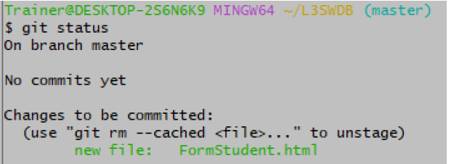
An example that shows the case
From that image before, there are no untracked files

Slide 66
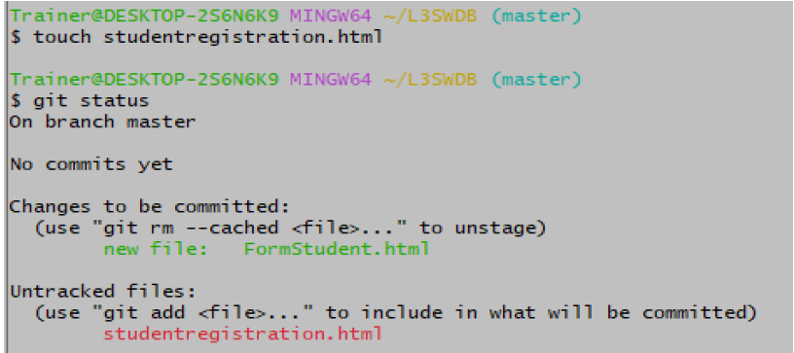
Let us create a file called “studentregistration.html” inside our repository by using touch File name
Then, after running git status and seeing what happens

Slide 67
In that case, it displays studentregistration.html as untracked because it has been created but not staged, which means that it is under the working stage.
2.2 View modified file
Let's assume you have a Git repository with some files, and you have made changes to one of the files. Follow these steps to view the modified file:
1. Open your terminal or command prompt.
2. Navigate to the root directory of your Git repository using the `cd` command. For example: cd /path/to/your/repository
3. Run the `git status` command:
This command will display the current status of your repository, including any modified files.

Slide 68
4. Look for the section labeled "Changes not staged for commit". It will list all the modified files in your working directory.
For example: Changes not staged for commit:
(use "git add <file>..." to update what will be committed)
(use "git restore <file>..." to discard changes in working directory)
modified: file.txt
In this example, `file.txt` is the modified file.

Slide 69
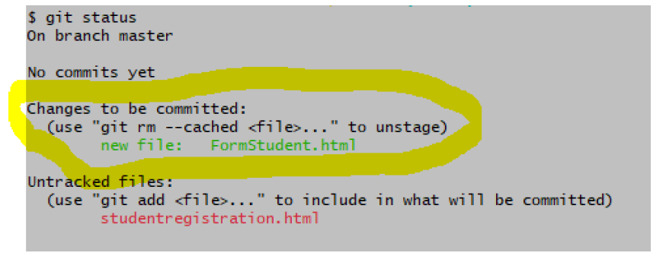
All modified files or changed files are viewed by using Git status

Slide 70
2.3 View deleted file
To view deleted files in Git, you can use the `git status` command.
Here's a clear example of how to do it practically:
Assuming you have a Git repository and you have deleted a file. Follow these steps to view the deleted file:
1. Open your terminal or command prompt.
2. Navigate to the root directory of your Git repository using the `cd` command. For example:
cd /path/to/your/repository
3. Run the `git status` command:

Slide 71
git status
This command will display the current status of your repository, including any deleted files.
4. Look for the section labeled "Changes not staged for commit". It will list all the deleted files in your working directory.

Slide 72
For example:
Changes not staged for commit:
(use "git add <file>..." to update what will be committed)
(use "git restore <file>..." to discard changes in working directory)
deleted: deleted_file.txt
In this example, `deleted_file.txt` is the deleted file.
By running `git status`, you can easily identify the deleted file in your repository. Git will display the file name and indicate that it has been deleted.

Slide 73
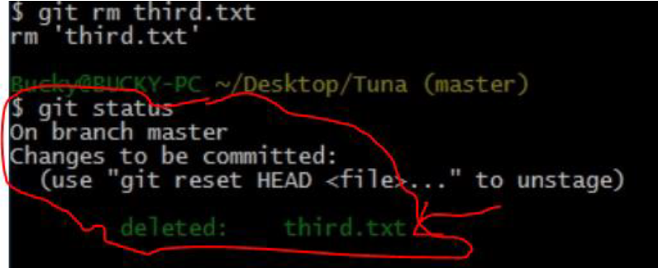
Remember that to delete a file you use git rm <filename> once you have deleted a file in git you can view them by using Git status.

Slide 74
3. Operation on the git add command
3.1 Stage all files
Git add files
The Git add command is a straightforward command. It adds files to the staging area. We can add single or multiple files at once in the staging area.
$ git add <File name>
The above command is added to the git staging area, but it cannot be shared on the version control system. A commit operation is needed to share it. Let's understand the scenario.

Slide 75
We have created a file for our newly created repository in NewDirectory. To create a file, use the touch command as follows:
$ touch newfile.txt
And check the status whether it is untracked or not by git status command as follows:
$ git status
The above command will display the untracked files from the repository. These files can be added to our repository. As we know we have created a newfile.txt, so to add this file, run the below command:

Slide 76
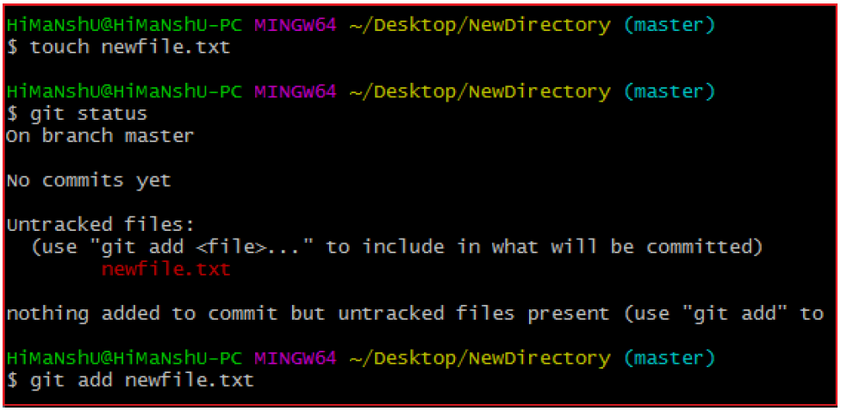
$ git add newfile.txt
Consider the below output:

Slide 77
From the above output, we can see newfile.txt has been added to our repository. Now, we have to commit it to share on Git.
3.2 Git Add All
We can add more than one file in Git, but we have to run the add command repeatedly. Git facilitates us with a unique option of the add command by which we can add all the available files at once. To add all the files from the repository, run the add command with -A option. We can use '.' Instead of -A option. This command will stage all the files at a time. It will run as follows:

Slide 78
$ git add -A
Or
$ git add.
The above command will add all the files available in the repository. Consider the scenario below:
We can either create four new files or we can copy them, and then we can add all these files at once. Consider the output:

Slide 79
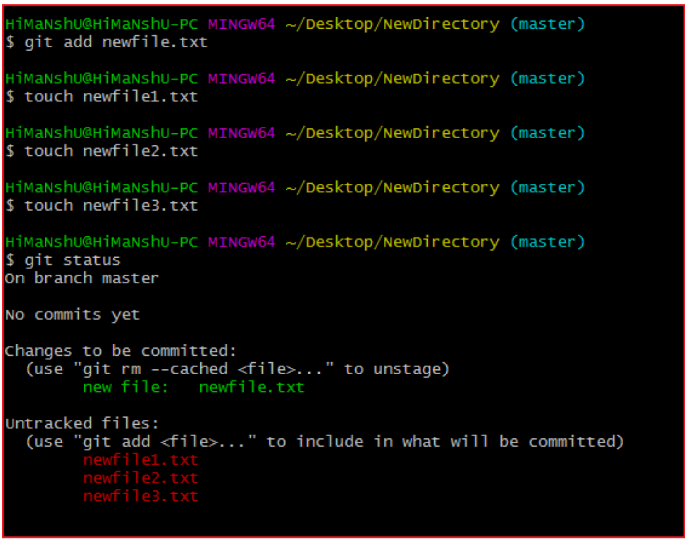

Slide 80
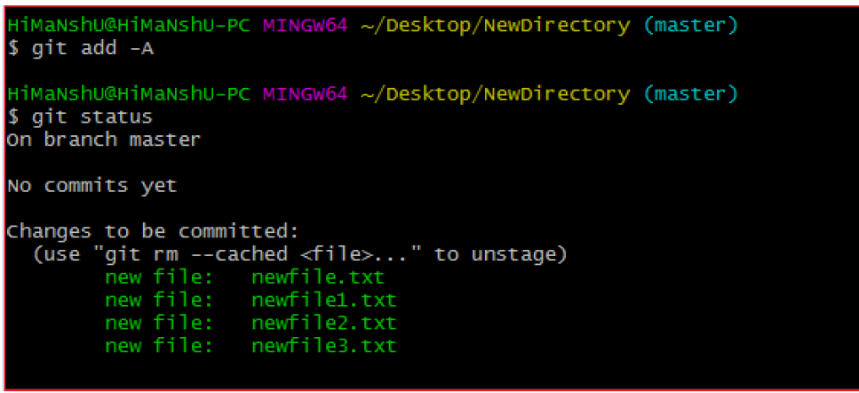
In the above output, all the files are displayed as untracked files by Git. To track all of these files at once, run the command:
$ git add -A
The above command will add all the files to the staging area. Remember, the -A option is case sensitive. Consider the below output:

Slide 81
In the above output, all the files have been added. The status of all files is displaying as staged.
3.3 Adding all files by extension
In some cases, you may be interested in adding all files that have a specific extension: *.txt or *.js, for example.
To add all files having a specific extension, you have to use the “git add” command followed by a wildcard and the extension to add.
$ git add *.txt
$ git add *.js

Slide 82
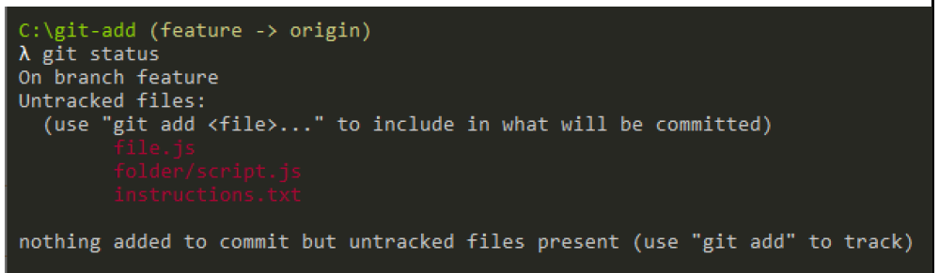
As an example, let’s say that you have created two JavaScript files and one text file.

Slide 83
3.4 Stage a file
The operation of staging a file using the "git add" command allows you to selectively include changes made to a specific file in the staging area. To stage a file, you specify the path to that file as an argument to the "git add" command.
For example: git add path/to/file.txt

Slide 84
Before staging a file, you have to check all existing files and unstaged files. For this, you use the ls command.
Remember that git add is used once, moving a file from the workspace to stagging area.
For staging a single file, use git add filename.extension
For file extension use .html, .doc, .js, and others.
Example: git add index.html. That command will add the index file to stagging area, as shown in that image.

Slide 85
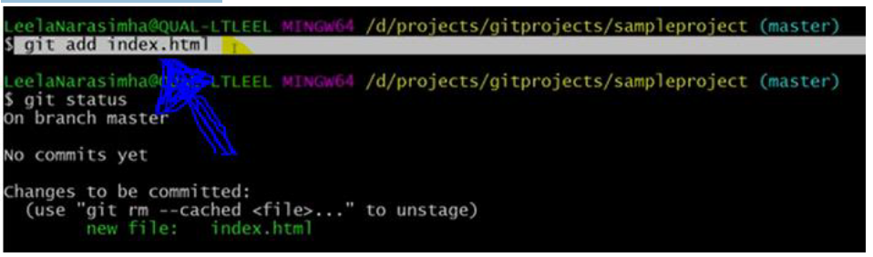
Once you want to stage all unstaged files at the sametime you write git add . or git add A

Slide 86
3.5 Stage folder
The operation of staging a folder using the "git add" command enables you to include changes made to multiple files within a directory and its subdirectories in the staging area. By executing the command:
git add path/to/folder/

Slide 87
To stage a folder in Git, you can use the `git add` command with the folder's path. Here's how you can do it practically:
1. Open your terminal or command prompt.
2. Navigate to the root directory of your Git repository using the `cd` command.
For example: cd /path/to/your/repository
3. Run the following command to stage a folder:
git add <folder>

Slide 88
Replace `<folder>` with the name or path of the folder you want to stage.
For example, if you want to stage a folder named "myfolder", the command would be: git add myfolder
This command stages the specified folder and all its contents for the next commit.
4. Verify the staged changes by running the `git status` command:
git status
You will see that the folder and its contents are now staged for the next commit.

Slide 89
For example:
Changes to be committed:
(use "git restore --staged <file>..." to unstage)
new file: myfolder/file1.txt
modified: myfolder/file2.js
deleted: myfolder/file3.html
By using `git add <folder>`, you can stage a specific folder and its contents in your repository. This allows you to include all changes within that folder in a single commit.

Slide 90
4. Operations on git reset command
The git reset command is used to undo the changes in your working directory and get back to a specific commit while discarding all the commits made after that one.
4.1 Unstage a file
In Git, to unstage a file that you've previously added to the staging area, you can use the "git reset" command. Here's how you can do it:

Slide 91
1. First, ensure you are in the root directory of your Git repository.
2.To check the status of your repository and see which files are staged and unstaged, use the following command:
If you see the file you want to unstage under the "Changes to be committed" section (staged changes), you can unstage it using the following command:
git reset HEAD <file>
For example, if you want to unstage a file named "example.txt," you would run:
git reset HEAD example.txt

Slide 92
This command moves the changes from the staging area back to the working directory, effectively "unstaging" the file.
After unstaging the file, you can verify its status using git status again.
4.2 Deleting and staging file/folder
Deleting and staging a file/folder involves two separate steps: deleting the file/folder from your working directory and then staging the deletion for the next commit. Here's how you can do it:

Slide 93
1. To delete a file from your working directory, you can use the standard file system command, such as rm on Unix-based systems or del on Windows. For example, to delete a file named "example.txt"
on Unix: rm example.txt
On Windows: del example.txt
Alternatively, you can use the Git command to delete the file, which will both remove it from the working directory and stage the deletion:
git rm <file>

Slide 94
For example:
git rm example.txt
2. After deleting the file, it is removed from the working directory, but its deletion is not yet committed. To stage the deletion for the next commit, you need to run:
git add <file>
For example:
git add example.txt

Slide 95
3. At this point, the file deletion is staged and will be part of the next commit. To complete the process, commit the changes:
git commit -m "Deleted example.txt"
5. Operations on rm command
5.1 Remove and Stage a File:
1. First, ensure you are in the root directory of your Git repository.
2. To remove the file from both the working directory and the repository (staged deletion), use the following command:

Slide 96
git rm <file>
For example, if you want to remove a file named "example.txt":
git rm example.txt
3. After running the git rm command, the file is removed from the working directory and staged for deletion. To complete the process, commit the changes:
git commit -m "Deleted example.txt"

Slide 97
Replace the commit message with an appropriate message for your changes.
5.2 Remove and Stage a Folder (Directory):
1.First, ensure you are in the root directory of your Git repository.
2.To remove the folder and its contents from both the working directory and the repository (staged deletion), use the following command:
git rm -r <folder>
For example, if you want to remove a folder named "examples":
git rm -r examples

Slide 98
Indicative content 2.2: Commit File changes to git local repository and manage branch
2.2.1: Introduction of commit file change to git local repository
1. Definition of Commit message
In Git, a commit message is a brief description that explains the changes made in a particular commit.

Slide 99

2.2.2 : Committing File changes to git local repository and manage branches
1. Commit file change
Here are the steps to commit file changes to a Git local repository:
1.Check Status: Before committing changes, it's a good practice to review the status of your repository using the command:
This will show you which files have been modified, added, or deleted.

Slide 100


2.Stage Changes: Use the "git add" command to stage the changes you want to commit. You can either stage specific files or stage all changes. For example:
To stage a specific file:
To stage all changes:

Slide 101

3.Verify Staging: Confirm that the changes you want to commit are staged correctly by checking the status again:
Staged changes will appear in green.
4.Commit Changes: Once you've staged the desired changes, commit them to the local repository along with a descriptive commit message using the "git commit" command:

Slide 102

Replace "Your commit message here" with a concise description of the changes you're committing.
5.Verify Commit: After committing the changes, you can verify that they have been successfully committed by reviewing the commit history:

Slide 103
This will display a list of commits, including the one you just made. Press "q" to exit the log.
6. Manage branches
6.1 Git Branch
A branch is a version of the repository that diverges from the main working project. It is a feature available in most modern version control systems. A Git project can have more than one branch.

Slide 104
The master branch is a default branch in Git. A repository can have only one master branch.
Master branch is the branch in which all the changes eventually get merged back. It can be called as an official working version of your project.
6.2 Operations on Branches
We can perform various operations on Git branches. The git branch command allows you to create, list, rename and delete branches.

Slide 105
The Operations that can be performed on a branch:
1.Create Branch
You can create a new branch with the help of the git branch command. This command will be used as:
Syntax: $ git branch <branch name>
Output:

Slide 106
This command will create the branch B1 locally in Git directory.
2.List Branch
You can List all of the available branches in your repository by using the following command.
Either we can use git branch - list or git branch command to list the available branches in the repository.

Slide 107
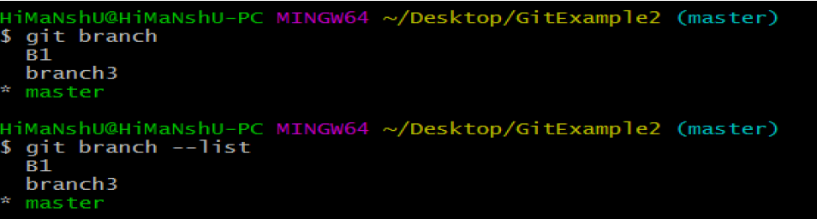
Syntax:
1. $ git branch --list or $ git branch
Output:

Slide 108
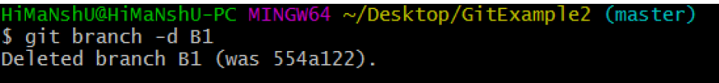
3.Delete Branch : You can delete the specified branch.
Syntax: $ git branch -d<branch name>
Output:

Slide 109
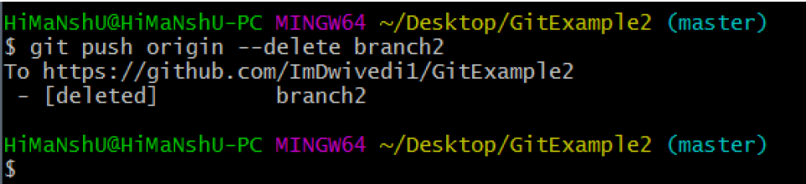
Delete a Remote Branch
You can delete a remote branch from Git desktop application. Below command is used to delete a remote branch:
Syntax: $ git push origin -delete <branch name>
Output:

Slide 110
4.Switch Branch
Git allows you to switch between the branches without making a commit. You can switch between two branches with the git checkout command. To switch between the branches, below command is used:
$ git checkout<branch name>
Switch from master Branch
You can switch from master to any other branch available on your repository without making any commit.

Slide 111
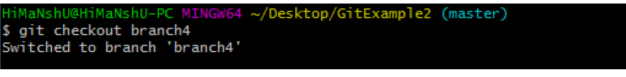
Syntax: $ git checkout <branch name>
Output:
Switch to master branch
You can switch to the master branch from any other branch with the help of below command.

Slide 112
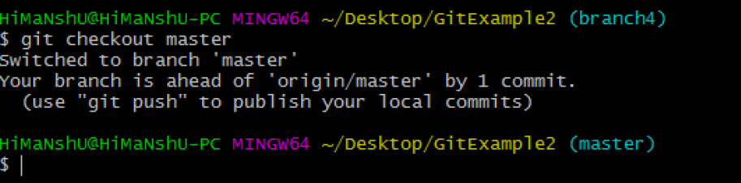
Syntax: $ git branch -m master
Output:
As you can see in the above output, branches are switched from branch1 to master without making any commit.

Slide 113
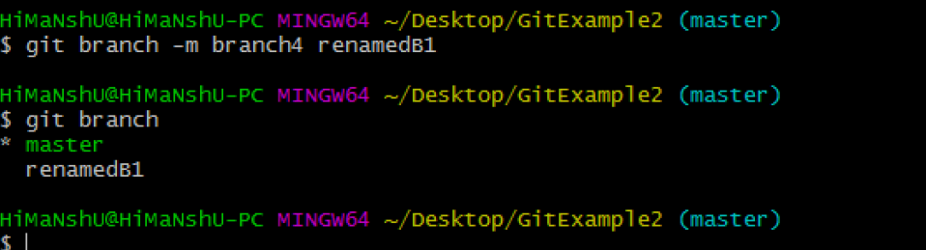
5.Rename Branch
We can rename the branch with the help of the git branch command. To rename a branch, use the below command:
Syntax: $ git branch -m <old branch name><new branch name>
Output:

Slide 114
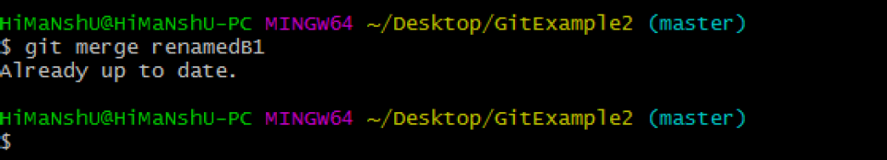
As you can see in the above output, branch4 renamed as renamedB1.
6.Merge Branches
Git allows you to merge the other branch with the currently active branch. You can merge two branches with the help of git merge command. Below command is used to merge the branches:
Syntax: $ git merge <branch name>
Output:

Slide 115
From the above output, you can see that the master branch merged with renamedB1. Since I have made no-commit before merging, the output is showing as already up to date.

Slide 116
Learning Outcome 3: Ship Codes
3.1 Fetch file from GitHub repository
3.1.1: Introduction of Fetching file from GitHub
Description of Fetching file from GitHub
1. Git Fetch
Git "fetch" Downloads commits, objects and refs from another repository. It fetches branches and tags from one or more repositories.

Slide 117
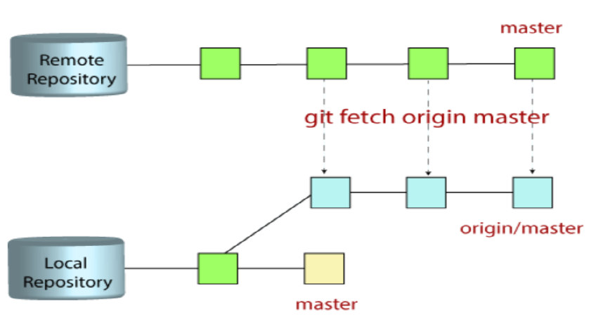

Slide 118
To better understand how git fetch works, let us discuss how Git organizes and stores commits. Git stores all commits, local and remote. Git keeps remote and local branch commits distinctly separate through the use of branch refs. Remote branches are just like local branches except they map to commits from somebody else’s repository. Remote branches are prefixed by the remote they belong to so that you don’t mix them up with local branches.

Slide 119
Fetch file from GitHub repository
The "git fetch" command is used to pull the updates from remote-tracking branches. Additionally, we can get the updates that have been pushed to our remote branches to our local machines.
1.1 Git fetch commands and options
git fetch <remote>
Fetch all of the branches from the repository. This also downloads all of the required commits and files from the other repository.

Slide 120
git fetch <remote> <branch>
Same as the above command, but only fetch the specified branch.
git fetch --all
A power move that fetches all registered remotes and their branches:
git fetch --dry-run
The --dry-run option will perform a demo run of the command. It will output examples of actions it will take during the fetch, but not apply them.

Slide 121
1.2 Git Pull
The term pull is used to receive data from GitHub. It fetches and merges changes from the remote server to your working directory.
The git pull command is used to pull a repository.

Slide 122
The git pull command is used to fetch and download content from a remote repository and immediately update the local repository to match that content.
Differences between git fetch and git pull
Some of the key differences between these commands are as follows:

Slide 123
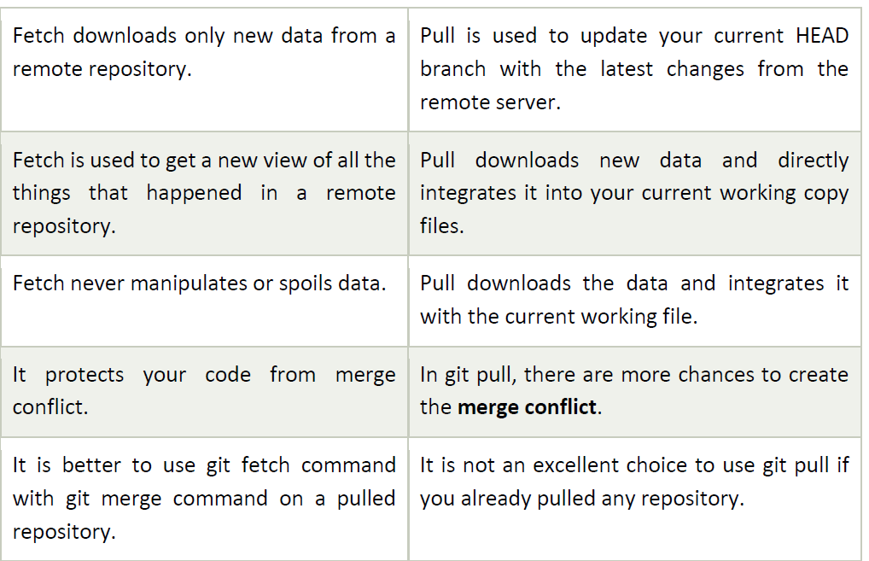

Slide 124
3.1.2: Fetching file from GitHub repository
Fetch a file from a GitHub repository
To fetch a file from a GitHub repository, you typically need to clone the repository to your local machine. Here are the steps:
1. Find the Repository: Go to the GitHub website and navigate to the repository containing the file you want to fetch.
2. Get the Repository URL: Click on the "Code" button, then copy the URL provided. It should look something like https://github.com/username/repository.git.

Slide 125
3. Open Terminal/Command Prompt: Open your terminal or command prompt on your local machine.
4. Navigate to the Desired Directory: Use the cd command to navigate to the directory where you want to clone the repository. For example:

Slide 126
5.Clone the Repository: Use the git clone command followed by the repository URL to clone the repository to your local machine:
6.Navigate into the Cloned Repository: Move into the cloned repository directory using the cd command:

Slide 127
Indicative content 3.2: Push files to remote branch
3.2.1: Description of Git push operations
1. Definition of Git Push
1. Definition of Git Push
Using the git push command, you can upload your files available on your local machine to the remote repository. After git pushes the changes to the remote repository other developers can access the changes and they can contribute their changes by git pulling. Before pushing it to the remote repository you need to do a git commit to your local machine.

Slide 128
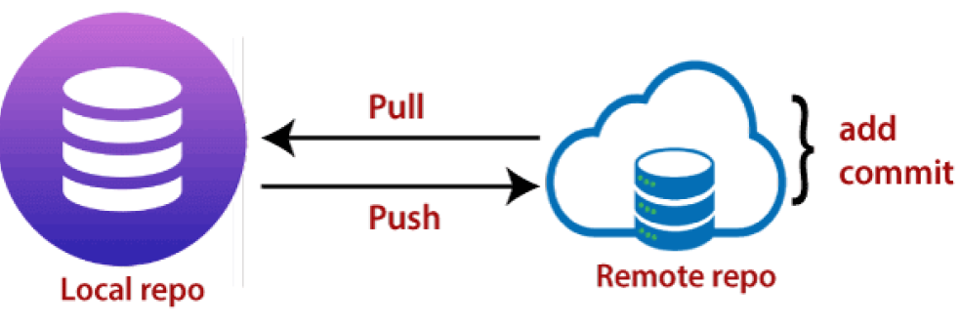
1.1 Git Push Command
Git push allows us to transfer files from the local repository to remote repository hosting services like GitHub, GitLab, etc.

Slide 129
Figure 17: Push diagram
In the above diagram, we can observe If our local main branch is way back when compared to the central main repository after that git push origin main will publish the changes. git push is essential as same as the git merge. git push <remote> <branch>
1. The <remote> option refers to the remote repository to which you want to push your files it will refer to its alias name where the name is mapped with the remote repository URL

Slide 130
2. The <branch> option represents the branch of the GitHub repository which you want to push.
The push term refers to upload local repository content to a remote repository. Pushing is an act of transfer commits from your local repository to a remote repository. Pushing is capable of overwriting changes; caution should be taken when pushing.

Slide 131
1.2 Description of Git Push Tags
<repository>: The repository is the destination of a push operation. It can be either a URL or the name of a remote repository.
<refspec>: It specifies the destination ref to update source object.
--all: The word "all" stands for all branches. It pushes all branches.
--prune: It removes the remote branches that do not have a local counterpart. Means, if you have a remote branch say demo, if this branch does not exist locally, then it will be removed.

Slide 132
--mirror: It is used to mirror the repository to the remote. Updated or Newly created local refs will be pushed to the remote end. It can be force updated on the remote end.
--dry-run: Dry run tests the commands. It does all this except originally update the repository.
--tags: It pushes all local tags.
--delete: It deletes the specified branch.
-u: It creates an upstream tracking connection. It is very useful if you are going to push the branch for the first time.

Slide 133
Indicative content 3.3: Merge branches on remote repository
3.3.1.: Description of merge branches on remote repository
1.Git Rebase
In Git, the term rebase is referred to as the process of moving or combining a sequence of commits to a new base commit. Rebasing is very beneficial and it visualized the process in the environment of a feature branching workflow.
git rebase is a Git command used to reapply a series of commits from one branch onto another branch.

Slide 134
2. Git Pull Request
Pull request allows you to announce a change made by you in the branch. Once a pull request is opened, you are allowed to converse and review the changes made by others.
3. Git Merge and Merge Conflict
In Git, the merging is a procedure to connect the forked history. It joins two or more development history together. The git merge command facilitates you to take the data created by git branch and integrate them into a single branch.

Slide 135
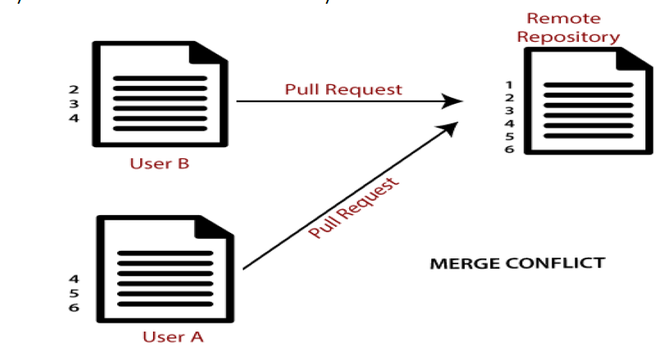
4. Git Merge Conflict
When two branches are trying to merge, and both are edited at the same time and in the same file, Git won't be able to identify which version is to take for changes. Such a situation is called merge conflict.

Slide 136
3.3.2: Applying Git merge commands
1. Merging branches
Merging branches on a remote repository involves several steps. Below are the general steps to merge branches on a remote repository, assuming you're using Git:
1. Fetch Remote Changes: Before merging branches, ensure you have the latest changes from the remote repository. Use the following command to fetch the latest changes:

Slide 137
Replace origin with the name of your remote repository if it's different. 2.Checkout the Target Branch: Switch to the branch into which you want to merge the changes. For example, to merge changes into the master branch:

Slide 138
3. Merge the Branch: Merge the changes from the source branch into the target branch using the git merge command.

